Slide 1



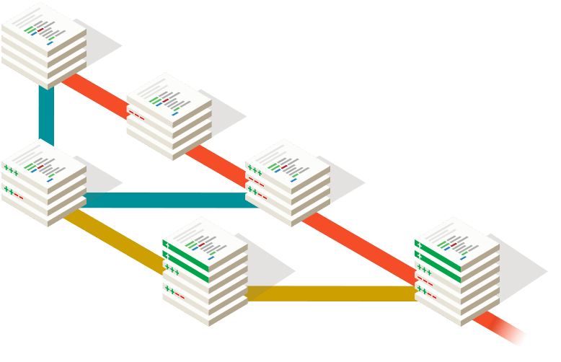
Git guideline for JLN team
Author: FQC.TQA
Editor: TuanCDN
Revision: 1.1
August 24, 2018 – HCM, VN

Slide 2

OBJECTIVES
Define
  Naming convention
  Git branches
For
  Better team collaboration
  Reduce duplicate tasks
  Reduce time/effort to merge code
  Better integrate with CICD system

Slide 3
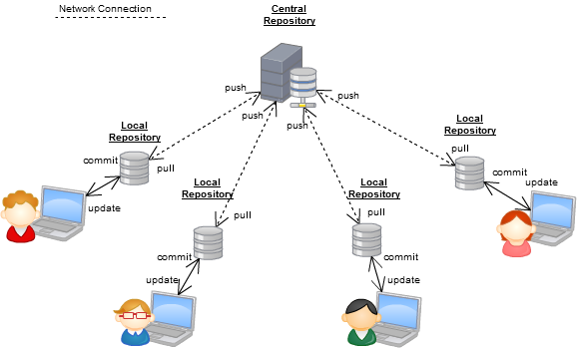
GIT Overview
Distributed
VCS

Slide 4
GIT Overview
# | GIT | Subversion
Distributed vs Centralized | Distributed Version Control System A GIT user will "clone" a repository from a remote server. Can do everything on your local machine: commit, inspect history, restore older revisions, etc. Only if you want to share your work with the world you have to connect to a remote server. | Centralized Version Control System A "checkout" from this central repository will place a "working copy" on the user's machine. “Working copy” is a snapshot from a certain version of the project on his disk.
Repository Structure and URLs | GIT repositories, on the other hand, consist of only a single ".git" folder in the root of a project. Addressing branches or tags is done via commands, not URLs. In GIT, the URL only points to the location of the GIT repository: ssh://git@example.com/path/to/git-repo.git | Organized with a couple of directories: "trunk" for the main line of development "branches" for alternative contexts "tags" to mark certain revisions. URLs: svn+ssh://svn@example.com/svn/[trunk|branches|tags|….]

Slide 5
GIT Overview
# | GIT | Subversion
Branching | Branching was one of the core design goals and therefore required a quite different concept. A branch in GIT is simply a pointer to a certain revision -> thereby creating no copy, no new directories, and no overhead | Directories that happen to have a special meaning. When creating a new branch, you effectively create a (very efficient) copy of your project in a new folder.
Committing | No need to online or connected to any "central" repository A file was changed doesn't mean it will automatically be included in the next commit. Need to add them to the so-called "Staging Area". Revision numbers are replaced by "commit hashes". | Only commit when you have a connection to the central repository. The commit gets instantly transferred to the central repository. It gets assigned an ascending revision number.
Sharing Work | Nothing gets uploaded automatically. Can decide for each of your branches when (and if at all) you want to share. Conflicts can only occur on your local machine and not on the remote server. | Automatically transferred to the central server when you commit. Committing is only possible when you can connect to this central server.

Slide 6
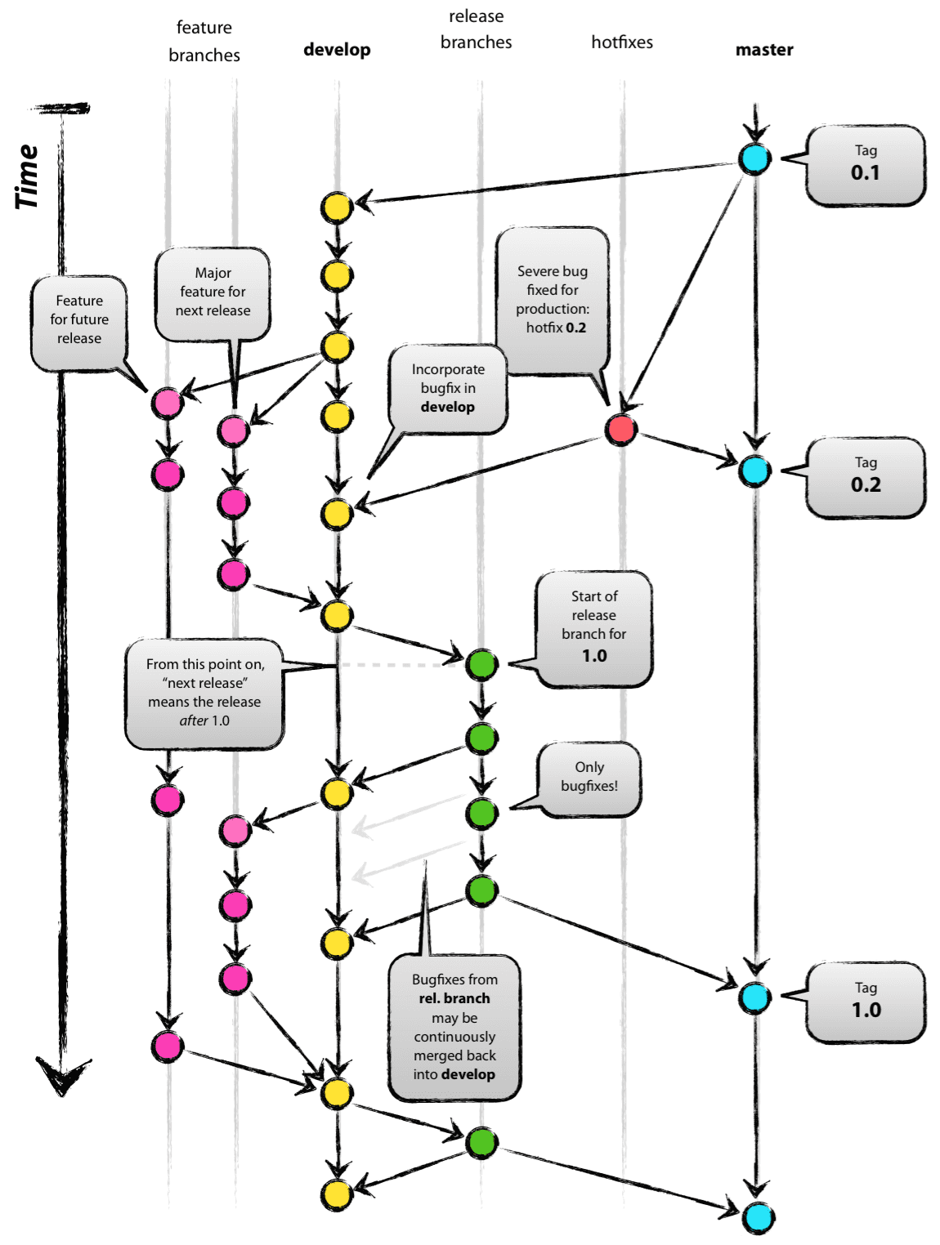
GIT - branches
A successful git branching model from the internet
It’s a good choice for large team size
But our team is small
We need to make it simpler
Let’s go next…

Slide 7
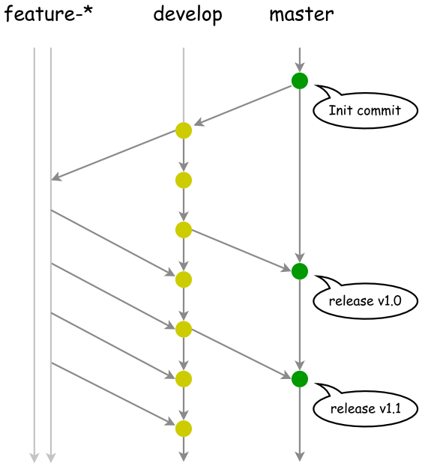
GIT - branches
master
  Merged from develop branch
  Trigger CICD build
  Anything in the master branch is always deployable
  Managed by PTL
develop
  Merged from feature-* branches
  Trigger CICD build
  Reflect current development status
  Managed by PTL

Slide 8
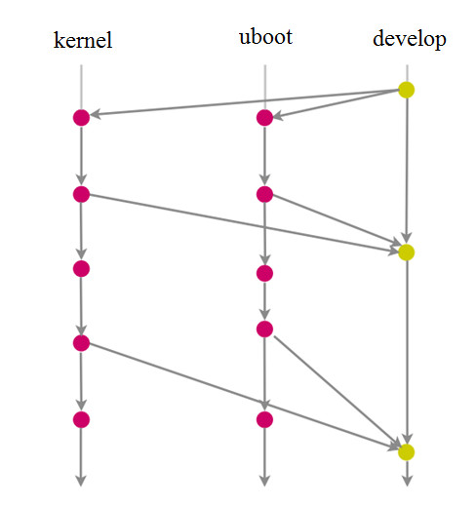
GIT - branches
3. features
  Merged by commits from developers
  Must merge back into: develop
  Naming convention
    Format: feature-*
    Example:
      kernel
      uboot
      utility
  Managed by module owners

Slide 9
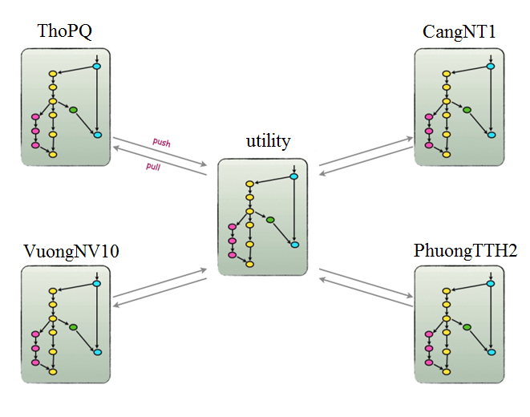
GIT - branches
4. feature-Utility
  Commit daily by developers
  Merge all commits to this branch by module owner
  Must merge this branch back into develop later when it’s in stable
Developer jobs
  Create many local branches that he wants
  Merge all these branches to an unique branch: feature-utility
  Push to gitlab remote server
  Go to https://git.fsoft.com.vn
  => create merge request
  Delete all draft branches when done.

Slide 10
GIT - commands
# get help
git <command> --help
# clone project from remote to local
- “git clone https://git3.fsoft.com.vn/fsoft/JLN2.git”
(use sudo if get 403 proxy error)
git config --global user.name “TuanCDN”
git config --global user.email TuanCDN@fsoft.com.vn
(Edit subject to your account and email)
git config –l
(to get your git configuration infomation)
#If certificate error happen use below cmd:
git config --global http.sslverify false
# Store username and password to avoid repeat input it again:
- “git config credential.helper store”
- “git push https://git3.fsoft.com.vn/fsoft/JLN2”

Slide 11
GIT - commands
# clone project from remote to local
- “git clone https://git3.fsoft.com.vn/fsoft/JLN2.git”
(use sudo if get 403 proxy error)
Turn off proxy :
“git config --global http.proxy "“ “

Slide 12
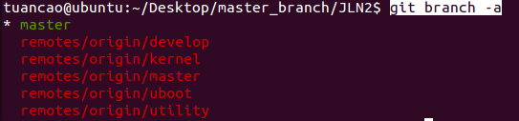


GIT - commands
# checkout to your branch before coding:
1. List all branch and check your current branch and list all branches
- “git branch –a”
2. Switch to your branch (example: kernel)
- “Git checkout kernel”
3. Update to newest revision

Slide 13
GIT - commands
# commit code change to repos
* Before using “git commit” cmd, member should do task below:
“Make clean” to remove all object file
Update by “git pull” cmd
Clean code subject to coding convention
Git commit cmd template:
- “Git commit –m “your comment” file_change_name”
Push change to repos:
- “Git push”
# Fix warning by using:
- “git config --global push.default simple”
# In case of push error ask your team lead for help.
# Git merge
TBD

Slide 14
GIT - commands
Other git cmd
# see current working repo status
- “git status”
# temporary store changes without need to commit
- “git stash” # store
- “git stash pop” # restore
“git stash drop” # delete

Slide 15
GIT - commands
# Fetch changes from remote to local
- “git fetch –all”
# compare current working repo with HEAD
- “git diff”
# compare local “develop” with remote “develop” branch
- “git diff develop origin/develop”
# view remote urls
- “git remote –v”
# references:
[1] https://orga.cat/posts/most-useful-git-commands
[2] https://gist.github.com/garystafford/5565f0b54e917b5e8750
[3] https://about.gitlab.com/2015/02/19/8-tips-to-help-you-work-better-with-git/
# git gui (linux):
[1] gitk (default)
[2] https://www.gitkraken.com/
[3] https://www.open.collab.net for giteye

Slide 16
GIT - commands
# Push new patch set for review
$ echo "patch 1" > test.txt
$ git add test.txt
$ git commit -m "my test commit"
$ git push origin HEAD:refs/for/master
remote: New Changes:
remote: http://10.88.14.210:8080/#/c/20pf/cosmos/jvckenwood/utilities/dbg_daemon_starter/+/xxxxxxxxxxxxxx
# Amend previous review message
$ echo "patch 2" > test.txt
$ git commit --amend -m "my test commit (amend)"
$ git push origin HEAD:refs/changes/xxxxxxxxxxxxxx
remote: Updated Changes:
remote: http://10.88.14.210:8080/#/c/20pf/cosmos/jvckenwood/utilities/dbg_daemon_starter/+/xxxxxxxxxxxxxx

Slide 17

Thank You

